Slide 1
CURRENT DEVELOPMENT IN THE NIGERIAN ELECTRICITY SUPPLY INDUSTRY
Key note presentation at
2019 LAGOS BREAKFAST CLUB MEETING, ORIENTAL HOTEL VICTORIA ISLAND
BY
PROF. JAMES a. MOMOH, FIEEE, FAEng, FAS, FNSE
Chairman/CEO, Nigerian Electricity Regulatory Commission (NERC)
NOVEMBER 6, 2019
Electricity on Demand

Slide 2
Outline
Introduction
Who we are
What we do
Where are we
Economic Outlook
Electricity Outlook
Highlight on the Power sector Reform
Market Development Stages
Current Technical State of the Power Sector
The Big Idea: Front Burner Issues in Nigeria Electricity Supply Industry (NESI)
Nigeria’s Energy Statistics
Regulatory interventions to Sector Challenges
NERC Minor Review and Minimum Remittance Order
Where are we headed? Next phase of the reform
Conclusion

Slide 3
Who we are
The Nigerian Electricity Regulatory Commission (NERC) was established in 2005 by the Electric Power Sector Reform Act (EPSRA):
to create, promote, and preserve an efficient electricity industry and market structures;
to ensure that adequate supply of electricity is available to consumers in Nigeria;
to ensure the safety, security, reliability, and quality of service in the production and delivery of electricity to consumers;
to ensure the optimal utilization of resources for the provision of electricity services;
to ensure that the prices charged by licensees are fair to consumers and are sufficient to allow the licensees to finance their activities;
to ensure that regulation is fair and balanced for licensees, consumers, investors, and other stakeholders.

Slide 4
What we do
Establish and enforce appropriate operating codes and safety, security, reliability, and quality standards;
Establish and enforce appropriate consumer rights and obligations regarding the provision and use of electric services;
License and regulate persons engaged in the generation, transmission, system operation, distribution, and trading of electricity;
Approve amendments to the market rules;
Monitor the operation of the electricity market; and
Undertake such other activities which are necessary.

Slide 5
Our strategic focus
Creation of Financially Viable Electricity Market
Metering for all within 3 years
Effective Compliance Monitoring & Enforcement
Institutionalized Corporate Governance
Recapitalization of Licensees in the Sector
Sustained Growth in Availability and Quality of Supply
Enhancement of the Nation’s Security of Supply for Electricity
Promotion of Local Content and Man Power Development in the NESI
Enforcement of Safety Standards
Establishment of Standard for Customer care
Develop Strategic Communication
Development of New Markets

Slide 6
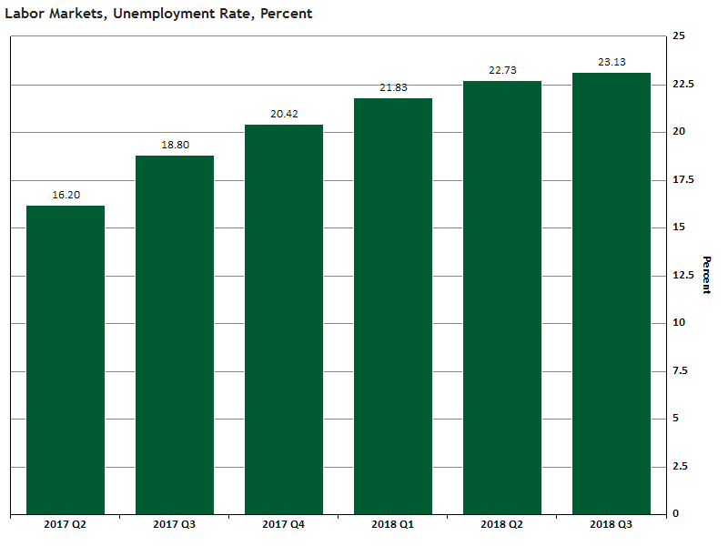
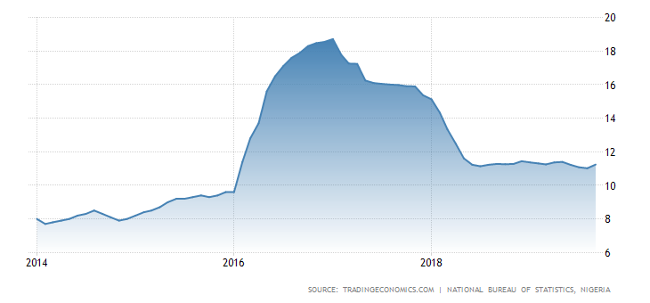
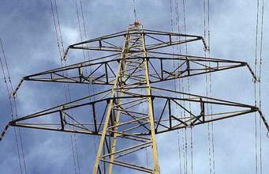
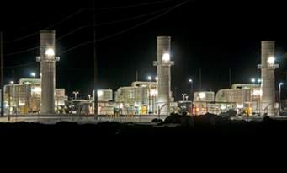
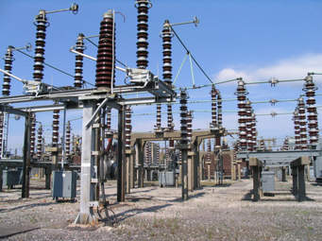
WHERE ARE WE: Nigerian economic outlook
Inflation Rate
Gross Domestic Product GDP

Slide 7
Where are we ?-Nigeria’s ELECTRICITY OUTLOOK
Installed Capacity: ▪ Thermal: ▪ Hydro: | 12,522 MW 10,142 MW 2,380 MW
Average Sent Out Generation per Hour 2018 Average Transmission Loss Factor (TLF) 2018 Aggregate Technical Commercial & Collection (ATC&C) Losses of Discos in 2018 | 3,971MW 8.39% 49%
Current Population: | 208 million
Energy Consumption Per Capita | 129kWh Per Annum
Current Access Rate Urban Rural | 45% 55% 36%
Target period for Universal access | Year - 2030
Generation Capacity Target | 32GW by 2030
Renewable Generation Target | 30% by 2030

Slide 8
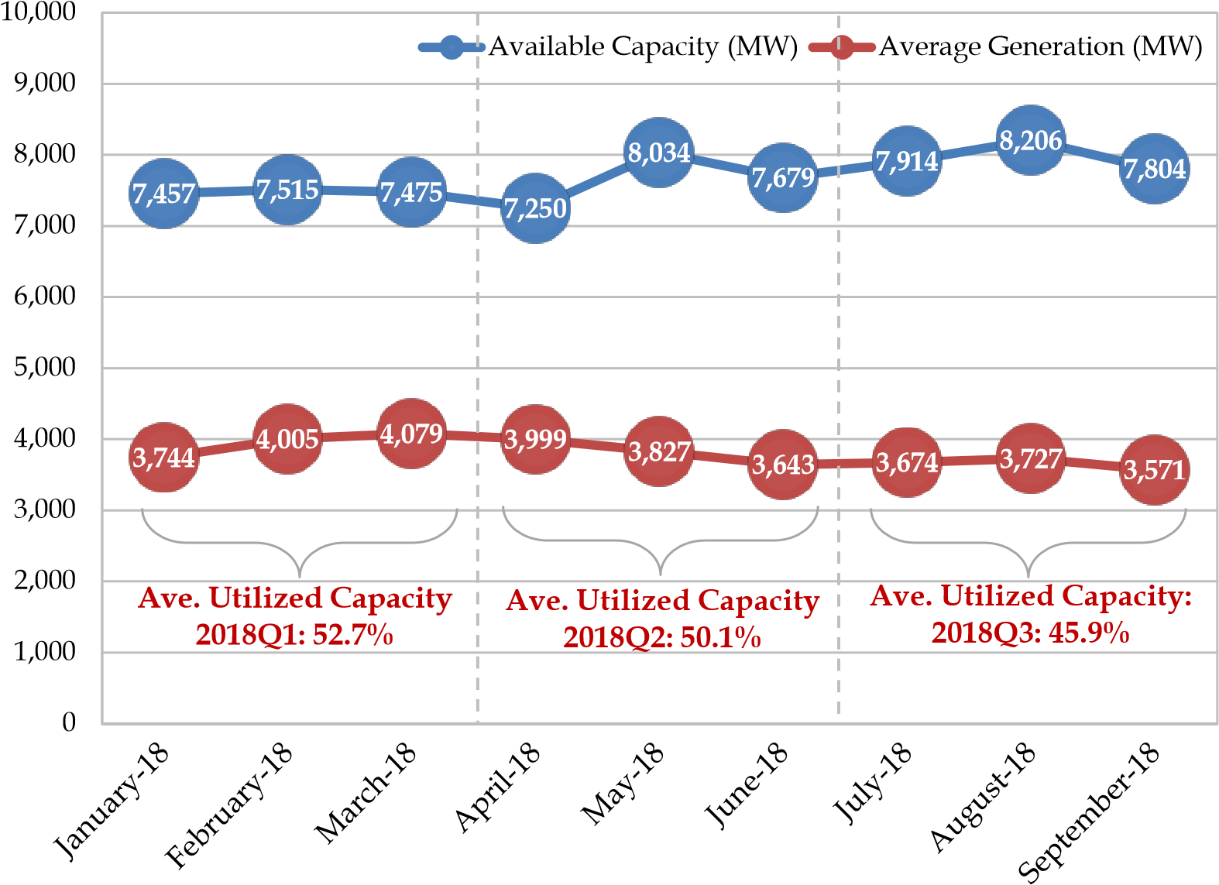
Where are we ?Average Daily Generation and Available Capacity 2018
Megawatts (MW)

Slide 9
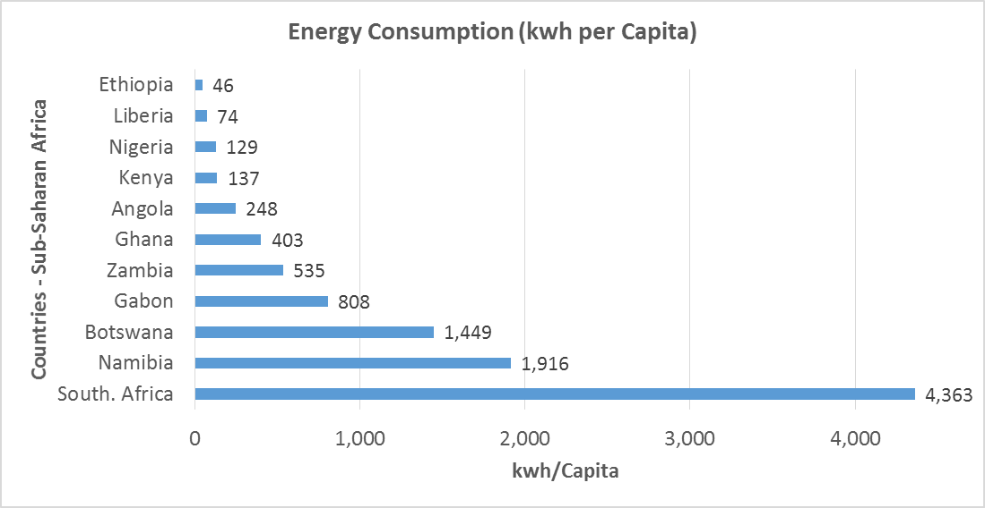
Where are we? Energy Consumption in Sub-Saharan Africa
Source: Nigerian Power Sector Investment Guide, 2016

Slide 10
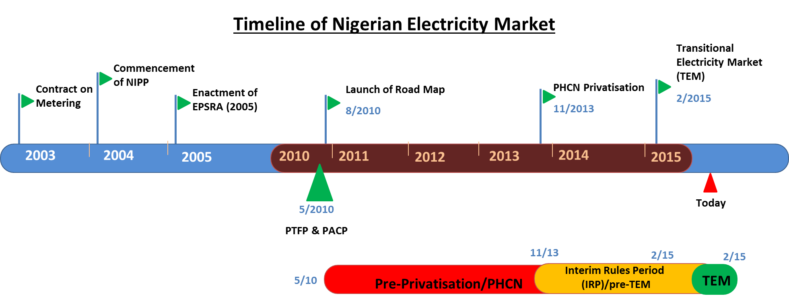
Highlight on the Power sector Reform

Slide 11
Highlight on the Power sector Reform
Unbundling of the Power Sector
Integrated Industry
Vertical unbundling Industry
Horizontal Unbundling
National Utility
Generation Companies
GenCos
Existing IPPs
Transmission Company
Transmission Company
Distribution Companies
DisCos

Slide 12
Highlight on the Power sector Reform
Privatization Strategy
Distribution
Transmission
Generation
Core-investor Sale
Emphasis on technical, financial and managerial competence
Loss reduction and investments, are the main parameters for assessing potential bidders
Aim at shortest curve to reduce subsidies & guarantees
Share benefits of efficiency with consumers
Investors provided opportunity on recovery of investments through MYTO
Initial 5-Year Management Contract
Management Contractor to oversee the entire TCN operations including Market and System Operations
Management Contract will bring required expertise to transform TCN into a world class company
Technical loss reduction and network improvement Criteria to be adopted in selecting the Management Contractor
Creation of Transmission Investment Fund in line with MYTO projection of annual transmission investment.
Core-Investor Sale of thermal IPPs
Concession of hydro Plants
Template Power Purchase Agreement with NBET
Technical, financial and managerial competence
Investment plan to recover stranded capacities

Slide 13
Market Development Stages
NESI Segment | Market Stages
 | Pre-transition | Transition | Medium Term | Long Term
Generation contestable market open to multiple competing operators; When fully competitive requires less regulation; Investments last for many years Technology type – coal, gas, oil, hydro, nuclear, wind, wave, etc. | Regulated prices through Minimum funding based on legacy contracts through the Market Operator | Regulated prices using wholesale contracts based on life cycle cost of an efficient new entrant with the special trader | Partly unregulated (based on bilateral contracts) | Unregulated based on bilateral contracts through competition
 |  |  | part regulated based on wholesale contracts (matched by regulated load) with the special trader
Transmission Natural Monopoly; Responsible for power lines of 132KV and above Transmits power between Gencos and off-takers (Discos & eligible customers) on an open-access; Procures ancillary services to manage grid; Manage the settlement system | Regulated Prices under minimum funding requirement | Regulated Prices under an incentive-based tariff regime | Regulated Prices under an incentive-based tariff regime | Regulated Prices under an incentive-based tariff regime
Distribution Monopoly operation in designated franchise area; Manage network power lines below 132KV; Distribute and sell electricity to end users on basis of regulated tariff; | Regulated Prices under minimum funding requirement | Regulated Prices under an incentive-based tariff regime | Regulated Prices under an incentive-based tariff regime | Regulated Prices under an incentive-based tariff regime
Retailing contestable market open to multiple competing operators; When fully competitive requires less regulation; | Regulated Prices under minimum funding requirement | Regulated Prices under an incentive-based tariff regime | Regulated Prices for regulated load | Unregulated (all load is contestable
 |  |  | Unregulated prices for the contestable load

Slide 14
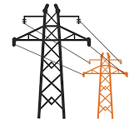
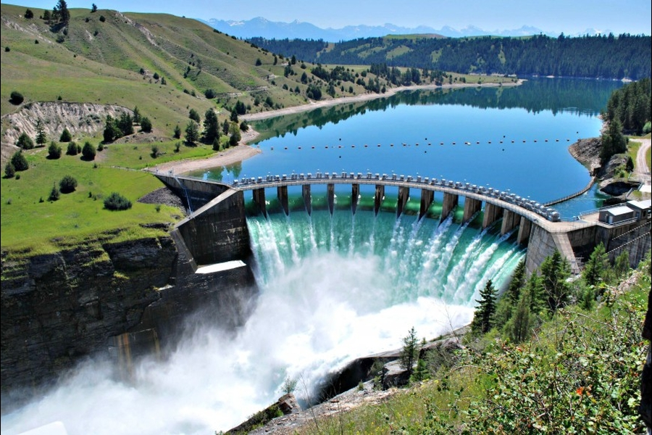
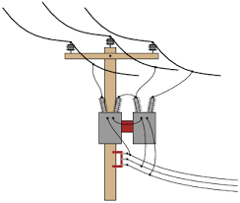
Current Technical State of the Power Sector in Nigeria
NERC has identified remedial plan with TCN and Discos on addressing key interface challenges in short, medium and long terms.
We envisage that additional capacity of 3,863MW will be made available within the next 24 months in boosting supply services to customers.
Fuel infrastructure
(about 4,000MW)
Distribution
(about 5,500MW)
Generation
(about 8,000MW)
Transmission
(about 7,000MW)
The rotating outages (system collapse) currently being experienced in the national grid will end.
Identified investment needs will assist the Discos in the submission of their PIP for NERC’s consideration.

Slide 15
THE BIG IDEA: Front Burner Issues in NESI
Premium Service
Willing-buyer Willing-seller
Cost reflective Tariffs
Investment in Networks
Available Meters
New Technology
Choice
Incremental
New Markets
MAP
Mini-grids
Eligible Customers
Sub-franchise

Slide 16
Regulatory interventions to Sector Challenges
NESI Segment | ISSUES (TECHNICAL /COMMERCIAL/CUSTOMER/LEGAL)
GasCos | Gas supply shortages Vandalism of gas infrastructure Timely settlement of gas invoices Bank guarantees for committed capacity Fully active GSAs and GTAs
GENCOS | Adequacy of generation investment Generation dispatch / Merit Order issues Timely settlement of energy invoice by NBET Availability of fuel (gas) based on effective GSA and GTA LDs for non-availability of gas Bank guarantee from NBET on PPA Fully active PPAs Poor maintenance and availability of power plants Take-or-pay gas and power capacity payments

Slide 17
Regulatory interventions to Sector Challenges
NESI Segment | ISSUES (TECHNICAL /COMMERCIAL/CUSTOMER/LEGAL)
TCN | Cost Reflective tariffs System Expansion Plan Optimal TLF reduction Efficient dispatch of power plants Procurement of adequate spinning reserve Timely Settlement of Invoices by Discos Poor Relay Coordination G/T and T/D Interface Challenges Poor Grid Reliability.
Disco | Poor Networks Operation High ATC&C Losses Insufficient metering of customers Lack of Cost-reflective Tariffs Poor customer Care and information/records T/D Interface issues Customer Apathy to bills settlement Bills Non-Settlement of MDA Debts

Slide 18
Key Regulatory Interventions
Meter Assets Providers (MAP) Regulation: The MAP Regulation targets investments from third parties to earnestly bridge the metering gap and ensure metering of all customers within 3 years. There are huge opportunities for investments and other project development support.
Design and Procurement of Customer Complaint Management System (CCMS): The CCMS is an industry-wide software that will monitor, track and document customer complaint handling.
Eligible Customer Regulation: This regulation creates an opportunity for large customers (2MWh/h) to procure electricity directly with licensed generation companies through a framework that provides open access to transmission and distribution networks as a precursor to full retail competition.
Implementation of Power Sector Recovery Programme (PSRP): The PSRP is Federal Government of Nigeria’s Policy that provides a detailed action plan with clear tasks and time frames for the various stakeholders to implement in order to strengthen the sector’s institutional framework, increase transparency and restore confidence in the sector.
Mini-Grid Regulation: This regulation seeks to improve access (less than 1MW) to quality supply in unserved and underserved areas, using a simplified tariff methodology;
Embedded Generation Regulation: This regulation provides for Independent Power Generators to supply directly at the distribution Voltage level near the power consumption (Load) centers.
Distribution Franchising Regulation: In view of the need to open up the distribution sector for desired investment, this regulation provides the framework for DisCos to authorise third parties to provide electric distribution utility services on its behalf in a particular area/function

Slide 19
Key Regulatory Interventions
8. Technical Codes and Standards:
Grid Code: Grid Code that contains the day to day operating procedures and principles governing the development, maintenance and operations of an effective, well coordinated and economic transmission system for the electricity sector in Nigeria.
Distribution Code: It contains the day to day operating procedures and principles governing the development, operation and maintenance of an effective and well coordinated and economic distribution system.
Metering Code: It contains the day to day operating procedures and standards to ensure that modern accurate metering systems with reliable communication facilities are deployed across the industry’s production and supply chains to measure and record energy production and utilization.
Construction Standards: The Commission has reviewed the review of CAP 106 Regulations and replaced with the construction standards that cut across generation, transmission and distribution known as Nigerian Electricity Supply and Installation Standards (NESIS) Regulations.
Health & Safety: Safety in the electricity sector is the responsibility of every one that produces, transports, supply and uses electricity. Every operator and user of electricity needs to handle electricity in such a way that the safety of persons and equipment is ensured.

Slide 20
2019 MINOR REVIEW ORDER OBJECTIVES
The objectives of this Order are to:
Reflect the impact of changes in the Minor Review variables for the period 2016 – 2018 to determine the cost-reflective tariffs for the relevant years.
Ascertain revenue shortfalls in view of the differential between cost-reflective tariffs and allowed tariffs in the Nigerian Electricity Supply Industry (“NESI”).
Determine and recognise the historical (2015 – 2018) tariff deficits pursuant to the objective of resolving the impairment of the financial records of DisCos arising as a consequence of the deficits.
Develop and implement a framework to manage future revenue shortfalls in the industry including a minimum market remittance requirement to account for differences between cost-reflective tariffs and allowed tariffs.
Establish the interim payment arrangements, reaffirm the payment securitisation requirement and flow of funds from DisCos to NBET and the MO.
Steer the market to gradual activation of market contracts in line with the requirements of the Transitional Electricity Market (“TEM”).
Reaffirm the obligation of core investors in DisCos under the Performance Agreement and Share Purchase Agreements executed with the Bureau of Public Enterprises (“BPE”).

Slide 21
Minimum REMMITTANCE…
The PSRP provides for a gradual transition to cost-reflective tariffs with safeguards for the less privileged in the society.
It is proposed that an intermediate review in end-user tariffs on January 1, 2020 and transition to full cost-reflectivity shall be achieved by July 2020.
In the interim, the Federal Government, under the PSRP, has committed to fund the revenue gap arising from the difference between cost-reflective tariffs determined by the Commission and the actual end-user tariffs. The waterfall of market revenues during the transitional period shall be in line with the following:
All DisCos are obligated to settle their market invoices in full as adjusted and netted off by applicable tariff shortfall approved by the Commission.
All FGN intervention from the financing plan of the PSRP to fund tariff shortfall shall be applied through the NBET and the MO to ensure 100% settlement of market invoices as issued by Market Participants.
Under this framework, the minimum market remittance threshold for Discos is determined after deducting the revenue deficit arising from tariff shortfall from the aggregate NBET and MO market invoices.
Discos shall be availed the opportunity to earn their revenue requirement only upon fully meeting the following payment obligations:
Repayment of CBN-NEMS facility.
100% settlement of MO’s invoice based on the tariffs applied by the MO in determining respective invoices prior to this Order. Effectively, this Order places a freeze on the tariffs of TCN and other admin charges throughout 2019 at the rates applied in generating MO invoices for the period of January – May 2019.
Full settlement of 34% (on average) of NBET’s monthly invoices being the minimum remittance threshold prescribed in the respective Orders of the Discos.

Slide 22
2019 MINMUM REMMITTANCE OUTLOOK
Analysis of Remittance to NBET
Disco | 2018 | Jan-Jun 2019 | Minimum Remittance 2019
ABUJA | 33% | 32% | 45%
BENIN | 28% | 23% | 30%
EKO | 39% | 37% | 45%
ENUGU | 34% | 24% | 42%
IBADAN | 33% | 26% | 26%
IKEJA | 40% | 34% | 49%
JOS | 9% | 8% | 6%
KADUNA | 13% | 9% | 18%
KANO | 14% | 15% | 33%
PH | 17% | 16% | 21%
YOLA | 11% | 11% | 13%
Total Disco | 28% | 25% | 34%
Analysis of Remittance to MO
Disco | 2018 | Jan-Jun 2019*** | Minimum Remittance 2019
ABUJA | 32% | 49% | 48%
BENIN | 53% | 55% | 48%
EKO | 71% | 79% | 48%
ENUGU | 30% | 50% | 48%
IBADAN | 33% | 56% | 48%
IKEJA | 60% | 74% | 48%
JOS | 17% | 28% | 48%
KADUNA | 18% | 35% | 48%
KANO | 17% | 29% | 48%
PH | 23% | 47% | 48%
YOLA | 69% | 65% | 48%
Total Disco | 40% | 49% | 48%

Slide 23
Minor Review Assumptions and Results 2016 - 2021
Parameter | Unit | 2015 | 2016 | 2017 | 2018 | 2019 | 2020 | 2021
PA Effectiveness | PA Year | 1 | 2 | - | - | 3 | 4 | 5
Loss Target | % | 40% | 33% | 26% | 26% | 26% | 20% | 16%
Nigerian Inflation | % | 8.3% | 15.6% | 16.5% | 12.1% | 11.3% | 11.3% | 11.3%
US Inflation | % | 0.1% | 1.3% | 2.1% | 2.5% | 1.8% | 1.8% | 1.8%
Exchange Rate N/$ | N | 199.0 | 255.9 | 308.9 | 309.1 | 310.0 | 310.0 | 310.0
Average Capacity Delivered to Discos | GWh | 26,141 | 23,807 | 26,066 | 27,414 | 29,546 | 39,035 | 42,581
Generation Cost | N/kWh | 9.7 | 16.0 | 19.2 | 21.1 | 20.8 | 19.9 | 19.9
Transmission Cost | N/kWh | 3.0 | 3.6 | 3.8 | 3.8 | 7.8 | 6.5 | 6.3
End-User Cost Reflective Tariff | N/kWh | 33.7 | 45.7 | 47.5 | 50.4 | 54.5 | 45.1 | 42.6
End-User Allowed Tariffs | N/kWh | 25 | 29 | 31 | 31 | 31 | 40 | 43
Tariff Shortfall | N'000,000 | 165,217 | 263,502 | 322,270 | 402,573 | 522,233 | 80,980 | 0
Market Shortfall | N'000,000 | -159,205 | -317,382 | -405,471 | -470,468 | N/A | N/A | N/A
Bal. Due To/(From) Discos | N'000,000 | 6,012 | -53,880 | -83,201 | -67,895 | N/A | N/A | N/A
Cumulative Tariff Shortfall | N'000,000 | 165,217 | 428,718 | 750,988 | 1,153,561
Cumulative Market Shortfall | N'000,000 | -159,205 | -476,587 | -882,058 | -1,352,525
Total Bal. to/from to Disco | N'000,000 | 6,012 | -47,869 | -131,070 | -198,965

Slide 24
WHERE ARE WE GOING-the ROLE OF THE fEDERAL gOVERNMENT IN THE NESI
N213 Billion- The CBN-NEMSF Facility in 2015
N710 Billion- FG Power Assistance Fund
N600 Billion
Extra Ordinary Tariff Review
FG and Siemens Partnership
The World Bank

Slide 25
Next phase of the reform: New Paradigm
Restore NESI to a contract based TEM
Improve supply services by targeting PIP at interphase and loss reduction strategies
Define a gliding path towards cost reflective tariffs
Develop a funding mechanism to finance revenue shortfall
Improve governance and co-ordination among key players
Improve investors/lenders confidence on sector’s risk profile
Provide regulatory certainty and enforcement activities
Remove legal encumbrancers
Overcome technical bottlenecks
Engagement of new markets (MAP, Smart Metering, Mini grid etc)

Slide 26
Next phase of the reform: New Paradigm
Market sustainability through innovations
Competition, choice
Smart grid
Customers IT deployment, apps, customer care, choice
Cyber Security and the role of block-chain technology
Cashless electricity market

Slide 27
Key take-aways: challenges meet opportunities
How can we bridge the widening gap between installed/available generation capacity and demand?
How do we expand and grow the electricity consumption capacity for industrial and productive base of the economy?
Massive investment is required across the electricity value chain-GENCO, DISCO, TRANSCO, GASCO- How do we build consensus and confidence to grow investment in the sector?
In view of the economic impact of a possible rise in electricity prices, what other options exists to attain cost recovery in the sector?
Liquidity crises has become a threat to the provision of electricity services to consumers in Nigeria and government interventions are on a decline, what alternative policy prescriptions are available?
In view of inadequate investment by the distribution companies, what options exists in recapitalizing the DISCOS to be able to make necessary investment

Slide 28
Conclusion
Trends in the world economies and increasing national demands will put additional burdens on meeting the self-sufficiency and security goals in these areas of national development.
When contextualized, this means that a nation’s power sector can only be said to be sustainably developing if it is effectively positioned to support and anchor the economic and human development needs of today’s people, while primed to meet the energy needs of future generations;
The Nigerian power sector of over a 208 million people is still abjectly stuck and hovering around 4,500MW;
The Nigerian Electricity Supply Industry (NESI) therefore must transit towards sustainability, if it is to achieve social, environmental and economic growth. Solving Energy Challenges in Nigeria is solving about 50% of the Nation’s Problems:
Promoting Job creation for the teeming youths.
Promotion of sustainable energy for sustainable development which will promote support for emerging economies in water supply, access to school, access to health, access to roads and improved manufacturing capacity, ICT, transportation, agriculture

Slide 29
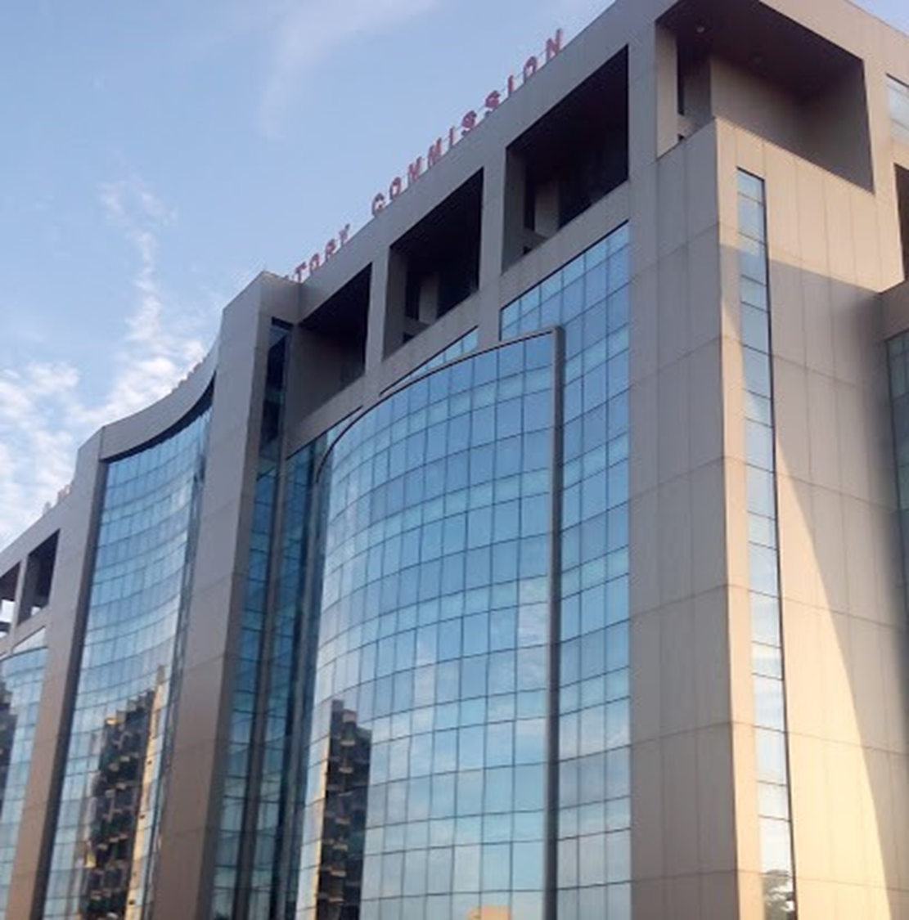
Thank You
Contact us at:
Plot 1387 Cadastral Zone A00,
Central Business District,
Abuja
Website: www.nerc.gov.ng
E-mail: info@nerc.gov.ng

